Slide 1
8089
康全電訊法人說明會
COMTREND CORPORATION 2022Q2 Earnings Conference
16th September 2022

Slide 2
投資安全聲明 Safe Harbor Notice
本簡報及相關內容，包含歷史資訊及前瞻性說明。前瞻性說明受到風險及不確定性因素影響，可能造成公司實際業績及成果與前瞻性說明有顯著差異。這些風險及不確定性因素包括國際經濟狀況、市場需求變化、商業環境、上下游供應鏈、競爭行為、資金運作能力、消費者變化、商業消費習慣、匯率波動、及其他各種本公司不能完全控制或根本不能控制的風險因素。
The statements contain historical information and forward-looking statements. Such forward-looking statements involve unknown risks and uncertainties, which may cause actual results to differ materially from those contained in any forward-looking statements.

Slide 3
公司簡介
COMPANY INFORMATION
1
2
2022年上半年財務概況
FINANCIAL RESULT
3
Q&A

Slide 4
COMPANY INFORMATION
1
公司簡介

Slide 5
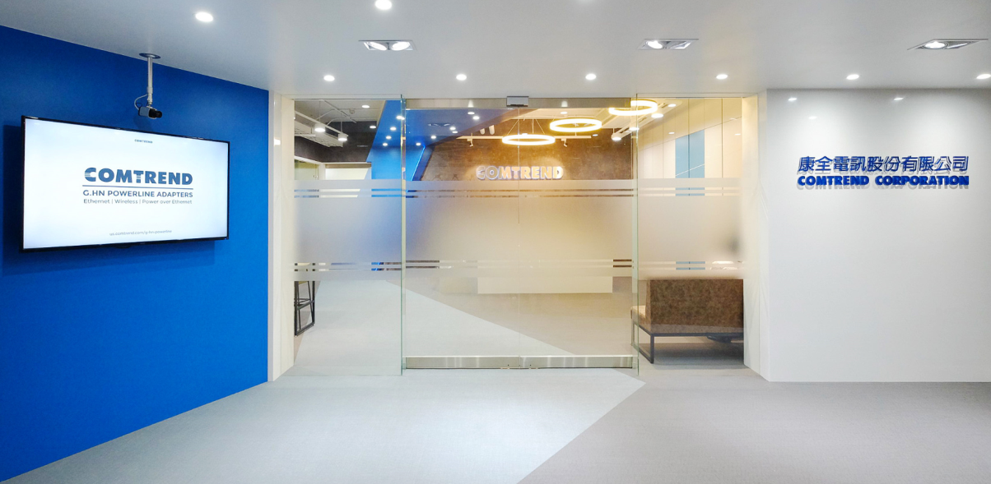
1
COMPANY INFORMATION
成立時間 1990年4月
董事長 任冠生
總經理 邱裕昌
實收資本額 NT$582M
員工人數 197人
主要產品 中繼接取設備
寬頻用戶端設備
家庭網路設備
營運總部 New Taipei City, Taiwan
子公司 USA, Spain, Czech

Slide 6
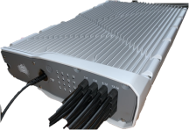
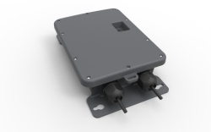
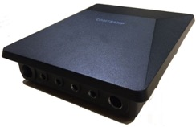
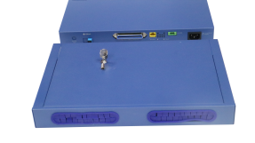
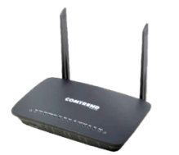
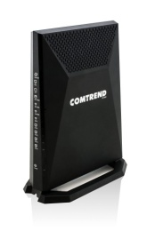
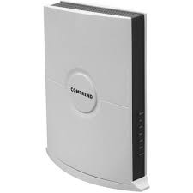
1
PRODUCT PORTFOLIO
中繼接取設備
Dense DPU
Single Port DPU
EOC DPU
Robust MDU
寬頻用戶端設備
Phoneline: Bonding Gateway
COAX: EOC Gateway
Fiber: XGS-PON Gateway
家庭網路設備
G.hn PLC + WiFi
G.hn Coax Adapter
Whole Home Wireless Solution
雲端管理系統
Auto Configuration Server
Telecom Grade Cloud Management System

Slide 7
FINANCIAL RESULT
2
2022年上半年財務概況

Slide 8
2
2022Q2綜合損益表 Income Statements
In Thousands of NTD
 | 2022Q2 | 2022Q1 | 2021Q2 | QoQ Diff | YoY Diff
Operating Revenue | 410,782 | 474,367 | 412,075 | (63,585) | (1,293)
Cost of Goods Sold | 294,552 | 314,084 | 289,728 | (19,532) | 4,824
GP | 116,230 | 160,283 | 122,347 | (44,053) | (6,117)
GP% | 28% | 34% | 30% | -6% | -2%
Operating Expenses | 146,308 | 156,465 | 122,295 | (10,157) | 24,013
Operating Profit (Loss) | (30,078) | 3,818 | 52 | (33,896) | (30,130)
Non operating Income(Expenses) | 11,571 | 10,818 | (5,431) | 753 | 17,002
Income(Loss) before Tax | (18,507) | 14,636 | (5,379) | (33,143) | (13,128)
Income Tax Expenses (Profit) | (2,137) | 9,504 | (6,045) | (11,641) | 3,908
Net Profit (Loss) | (16,370) | 5,132 | 666 | (21,502) | (17,036)
EPS (in NT$) | (0.28) | 0.09 | 0.01

Slide 9
2
2022H1綜合損益表 Income Statements
In Thousands of NTD
 | 2022H1 | % | 2021H1 | % | Diff
Operating Revenue | 885,149 | 100.00% | 759,651 | 100.00% | 125,498
Cost of Goods Sold | 608,636 | 68.76% | 516,060 | 67.93% | 92,576
GP | 276,513 | 31.24% | 243,591 | 32.07% | 32,922
Operating Expenses | 302,773 | 34.21% | 252,825 | 33.28% | 49,948
Operating Profit (Loss) | (26,260) | -2.97% | (9,234) | -1.21% | (17,026)
Non operating Income(Expenses) | 22,389 | 2.53% | (8,273) | -1.09% | 30,662
Income(Loss) before Tax | (3,871) | -0.44% | (17,507) | -2.30% | 13,636
Income Tax Expenses (Profit) | 7,367 | 0.83% | (7,987) | -1.05% | 15,354
Net Profit (Loss) | (11,238) | -1.27% | (9,520) | -1.26% | (1,718)
EPS (in NT$) | (0.19) |  | (0.17)

Slide 10
2
資產負債表 Balance Sheets
In Thousands of NTD
 | 2022/6/30 | % | 2021/12/31 | % | 2021/6/30 | %
Cash & cash equivalents | 670,579 | 33% | 482,213 | 27% | 951,536 | 47%
Accounts and other receivable | 310,733 | 15% | 364,988 | 20% | 399,928 | 20%
Inventory | 594,313 | 29% | 679,664 | 38% | 450,949 | 22%
Property and equipment | 298,302 | 15% | 45,411 | 3% | 45,452 | 2%
Right-of-use asset | 18,523 | 1% | 21,712 | 1% | 76,213 | 4%
Other assets | 124,000 | 6% | 190,431 | 11% | 116,840 | 6%
Total Assets | 2,016,450 | 100% | 1,784,419 | 100% | 2,040,918 | 100%
Short-term borrowings | 37,260 | 2% | - | - | - | -
Account payable | 345,821 | 17% | 380,182 | 21% | 389,101 | 19%
Long-term borrowings | 200,000 | 10% | - | - | - | -
Other Liabilities | 226,771 | 11% | 140,980 | 8% | 269,920 | 13%
Total Liabilities | 809,852 | 40% | 521,162 | 29% | 659,021 | 32%
Total Equity | 1,206,598 | 60% | 1,263,257 | 71% | 1,381,897 | 68%

Slide 11
2022H1銷售分析-產品別 Revenue by Product
2
2022H1
2021H1

Slide 12
2022H1銷售分析-區域別 Revenue by Region
2
2022H1
2021H1

Slide 13
3
Q & A

Slide 14
THANK YOU FOR
YOUR TIME

